Slide 1
Adaptive Customer Service Through Data Analytics And AI
Name: Abhishek Roy
ID No: 2020FC04110

Slide 2
Problem Statement
If we consider the flow of a typical service helpdesk ticket, when a customer calls the helpdesk, the customer is connected with a support executive (aka FLS) who would log the helpdesk ticket (in case of new ticket) or provide the current status of the ticket (in case of existing open ticket). The FLS executive would then route the customer to a different support executive (SLS) who would either try to resolve the issue by themselves or re-route it to a different executive who may be able to help. This process would continue until the ticket reaches an executive who is actually able to resolve the issue.
Each such reassignment/routing to a SLS is called Tossing. With each tossing/reassignment cycle, the customer experience as well as satisfaction tends to drop significantly and tickets remain open for a longer period of time resulting in SLA breach. This poor customer experience while dealing with the helpdesk can also result in significant impacts to the organization in the form of:
Increased MTTR
SLA breach
Increase in operational costs
Unhappy customers leading to churn

Slide 3
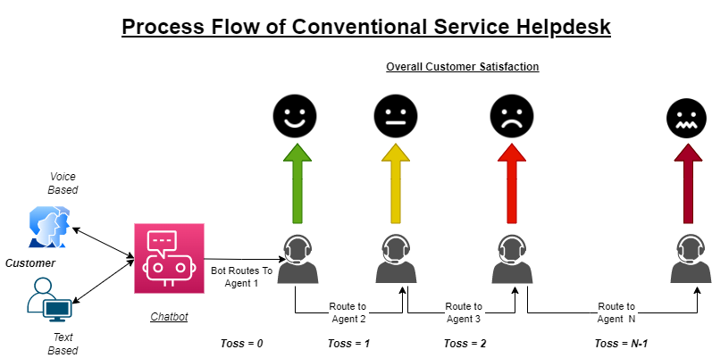

Slide 4
Objective Of The Proposed Solution
The objective of the proposed solution is to build a framework using AI (Including NLP and ML) in order to ensure a pleasant, personalized conversational experience with the machine as well as a swift resolution of service helpdesk query by routing the incident to the correct support executive/group who would be able to resolve the issue without further reassignment/tossing in the first place.
Benefits:
Reduced MTTR
Meeting SLAs
Significant decrease in operational costs
Significant improvement in terms of overall customer satisfaction
Personalized conversational experience.

Slide 5
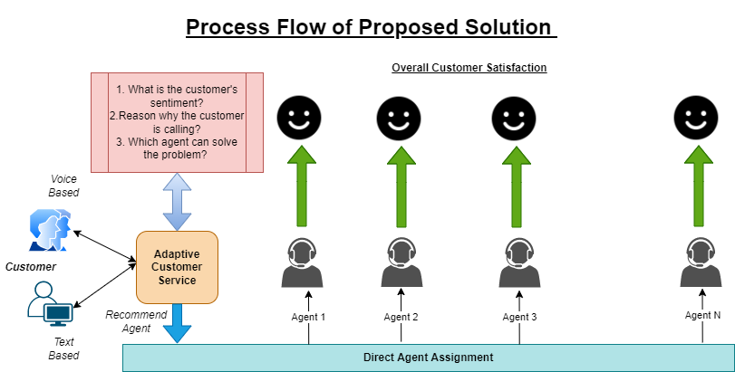

Slide 6
USP
The uniqueness of the solution lies in the fact that it plans to utilize AI/ML to ensure that the customer gets the resolution to their problem/issue as quickly as possible with best possible experience while dealing with the machine or a live agent. For achieving the same, real time voice transcription (in case of voice calls) along with sentiment analysis will be used to determine the current mood of the customer. Based on the sentiment, and based on recommendation from the engine (with customer sentiment taken into account), the appropriate support executive/group will be assigned to resolve the customer’s issue.
This will result in minimization of incident reassignment (i.e., tossing) as well as faster resolution and improvement in terms of operational costs. Also, when customer initiates the interaction with the helpdesk (via voice telephony-based call or chat), the engine will try to predict and proactively try to provide information and corresponding solution to the customer. This proactive/prescriptive approach in turn will result in a better customer experience leading to increase in customer loyalty and trust.

Slide 7
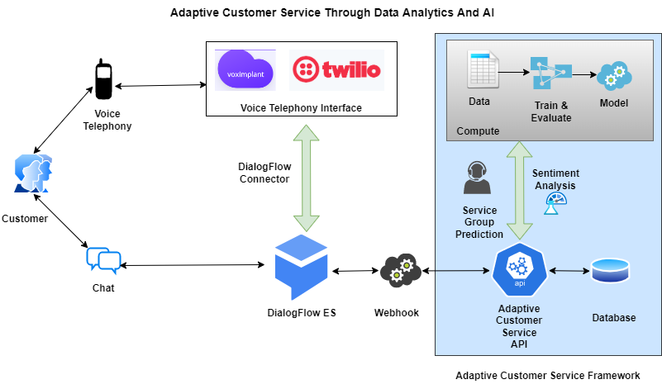
Solution Architecture

Slide 8
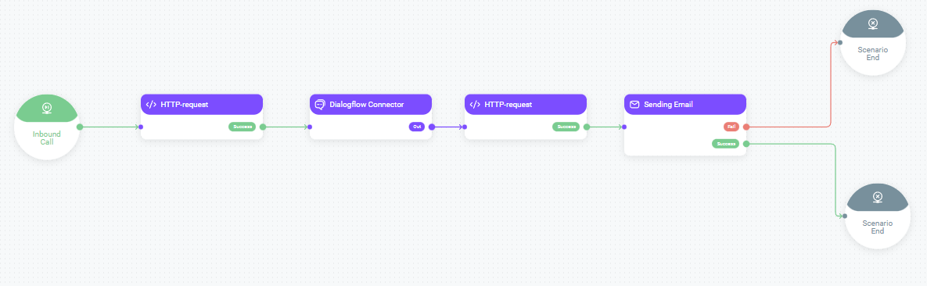
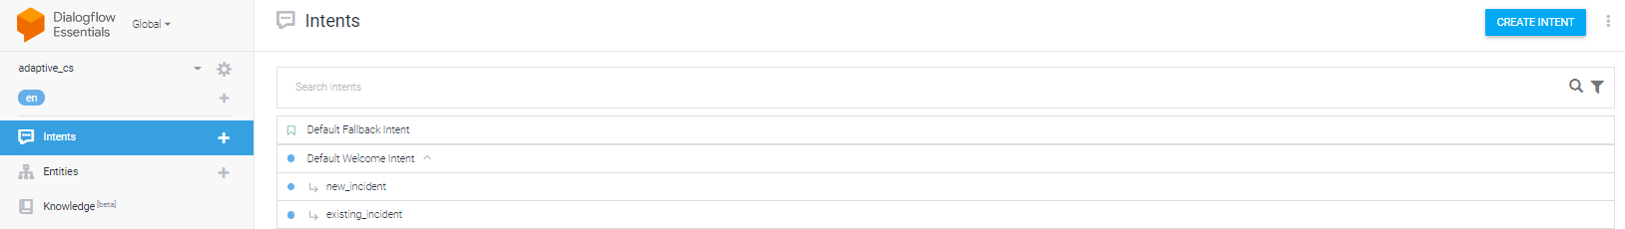
Process Workflow in VoxImplantkit and DialogFlow
VoxImplant Kit
DialogFlow ES Console

Slide 9
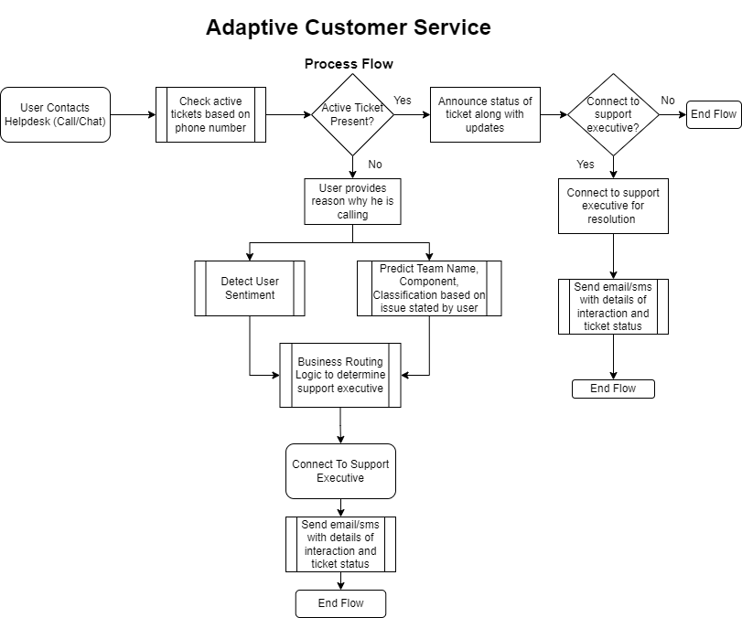

Slide 10
Infrastructure
Hardware:
Cloud based platform is preferred (GCP/AWS/Azure) for hosting the solution and training the models. However, due to cost effectiveness and lack of sufficient time, the solution has been hosted locally in a Windows 11 based machine with Intel i5 Quad Core processor and 16GB RAM.
Software/Tools:
Bot Framework - Google DialogFlow ES
Telephony Interface - VoxImplantkit (For Voice Telephony integration with DialogFlow)
Database - MySQL 8.0 Community Edition for hosting the database server.
Ngrock for port forwarding and tunnelling between local DB server and Dialogflow/VoxImplant.
Google Collab – Pro tier (For data processing and model training)
Microsoft VS Code/Jupyter Notebook for development.

Slide 11
Dataset
Mozilla Bug Tracker
This is an open-source dataset containing bugs that were logged for Mozilla support for all products that are supported by Mozilla.
The dataset consists of data of reported bugs from last three years.
Although the dataset is rich in details and contain all relevant attributes that we may require for this use case, however, the size of the dataset is not very extensive. It contains around 30,000 unique incidents along with their details (link).
Note: 2 other datasets were initially explored but later discarded owing to lack of details that are required for our use case
1. Service Now Enriched Event Log from UCI
2. Support tickets between Microsoft and Endava

Slide 12
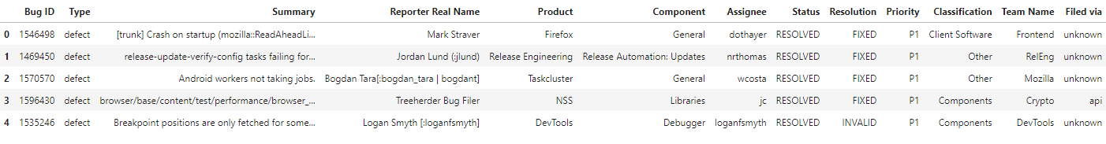
Feature Selection
Dataset has 13 attributes
Attributes Dropped
Bug ID
Reporter Real Name
Assignee
Status
Resolution
Target Attributes
Team Name
Component
Classification
Exploratory Data Analysis (EDA): link

Slide 13
Data Preparation
The following data preparation steps were applied to the data set:
TF-IDF: For the attribute “Summary”, Tokenization, removal of stop words and their stemming with respect to the bilingual symptom descriptions is done. The data records are then vectorized using the "Term Frequency-Inverse Document Frequency (Tf-Idf)“.
Class Imbalance Correction: The Dataset is class-imbalanced. To slightly counter the effect of class imbalance during model building, we have reduced the number of classes from the target variables by defining a minimum number of samples which are required to be present for each class to be considered
Note: Owing to lack of domain knowledge and SME inputs, conventional processes like resampling (over and under-sampling) could not be applied to the dataset.

Slide 14
Models Considered
Supervised Learning algorithms involving Probabilistic Learning and Non linear modelling were considered for the experiments.
Multinomial Naïve Bayes (NB)
Easy and fast machine learning algorithm used for classification.
Performs well in multi-class predictions.
Support Vector Machines (SVM)
Effective and memory efficient on high-dimensional spaces.
Performs relatively well when there is clear margin of separation between classes.
Logistic Regression (LR)
Easy and quick to implement.
Less prone to overfitting.
Neural Network using Multi Layer Perceptron (MLP)
Very effective at solving both linear and non linear problems.
Provides quick predictions after training and the same level of accuracy can be achieved irrespective of the size of dataset (big or small)
Note: Random Search was used for hyperparameter tuning of all the algorithms.

Slide 15
Model Evaluation
Multinomial Naïve Bayes With Random Search for Hyperparameter Tuning (Code) | Support Vector Machines With Random Search for Hyperparameter Tuning (Code)
Logistic Regression With Random Search for Hyperparameter Tuning (Code) | Multi Layer Perceptron With Random Search for Hyperparameter Tuning (Code)

Slide 16
Sentiment Analysis
2 Sentiment Analysis mechanisms taken into account for the solution
VADER (Valence Aware Dictionary and sEntiment Reasoner)
Google Natural Language API (embedded in DialogFlow)
Both mechanisms provide a sentiment score between -1 and +1 based on the input query.
The overall customer sentiment is calculated based on the 2 sentiment analysis mechanisms stated above.
A business rule is setup (dependent on the organization where solution is implemented) to ensure that if any customer query reaches a certain threshold for negative sentiment, the query is automatically routed to the appropriate authority within the organization (“Senior Manager” in our experiments) who is enabled to get it resolved.
This in turn would help in ensuring customer satisfaction.
(Code)

Slide 17
Final Model Selection
The following models were selected for predicting the target variables based on this analysis.
Note:
1. As evident from our initial analysis, our target variables suffer from uneven class distribution. Hence, while evaluating the best model for each target variable, we have considered the F1 score to ensure that the models are robust.
2. The predictions of the Target Variables will be used while routing the ticket to the support executive as described in process flow for Adaptive Customer Service.

Slide 18
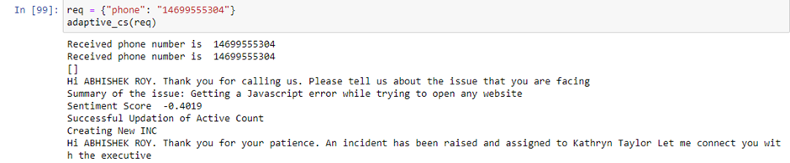
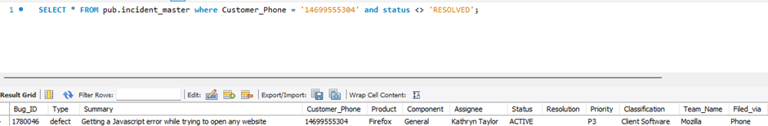
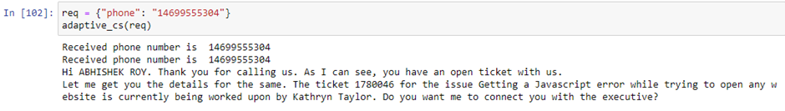
Sample Output 1 - Auto Assignment Based on Data Setup
New Incident Flow (With assignment based on customer sentiment)
New Incident Record created
Calling support while an active incident exists

Slide 19
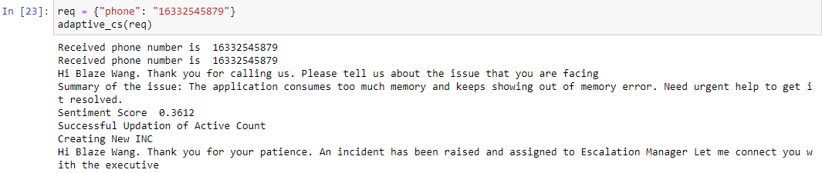
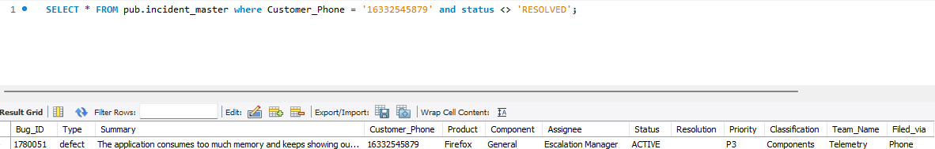
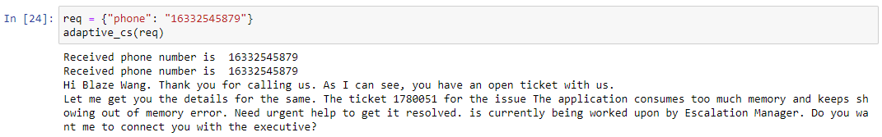
Sample Output 2 – Untriaged Case
New Incident Flow (With assignment based on customer sentiment)
New Incident Record created
Calling support while an active incident exists

Slide 20
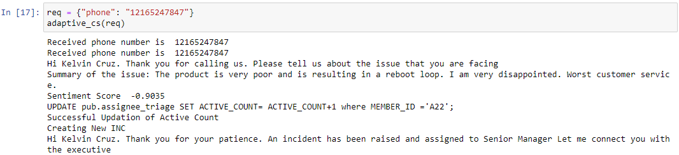
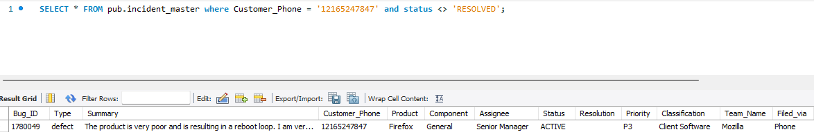
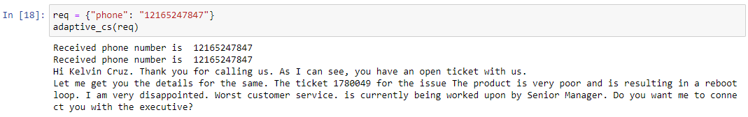
Sample Output 3 – Negative Sentiment
New Incident Flow (With assignment based on customer sentiment)
New Incident Record created
Calling support while an active incident exists

Slide 21
Benefits Of Proposed Solution
Reduced MTTR - MTTR (Mean Time To Repair/Recovery) is the average time that it takes to resolve an issue from the time the issue was reported. In general, a global study of IT professionals suggests that, every time a ticket is tossed from one support executive to another, about 30 minutes are lost owing to manual assignment. Also, as per data from an in-depth study on an average, an issue is tossed 3.5 times before it reaches the correct assignee and gets resolved which in turn would result in increased MTTR. With implementation of our proposed solution, tossing can be reduced by up to 74% thereby resulting in reduced MTTR.
Meeting SLAs - Service Level Agreements (SLA) are a key performance indicator (KPI) for any service helpdesk of any organization. On implementation of the framework, with significant reduction in tossing and thereby reduced MTTR, the SLA breach is also significantly reduced.
Significant decrease in operational costs – Studies have shown that an issue gets tossed multiple times before it is assigned to the correct executive and resolved. Each manual assignment can take up to 30minutes and post re-assignment (after first level of tossing), each ticket is picked up by the service executive after 4 hours in average. Thus, multiple reassignments i.e., tossing can cause not only significant delay in ticket resolution but also increase in operational costs owing to multiple agents spending time on the ticket owing to incorrect assignment. With the proposed solution framework, it has been seen that operational costs can be significantly reduced.

Slide 22
Benefits Of Proposed Solution(Continued)
Significant improvement in terms of overall customer satisfaction - Based on market analysis, it has been shown that only 45% of issues are accurately assigned by manual triaging. Overall, an issue gets tossed multiple times which in turn results in significant reduction of customer satisfaction. With the proposed solution framework (after further fine tuning), the system would be able to accurately assign tickets up to 86%. This would result in significant improvement in terms of MTTR and thereby improve the overall customer satisfaction.
Personalized conversational experience - The proposed solution framework uses customer data to personalize the conversational experience when customer calls the service desk. To start with, the system automatically identifies, if a user already has an active ticket and connects the user with the appropriate assignee in order to get the ticket resolved. At the same time, for new tickets, the system takes into account the customer sentiment along with the exact issue at hand in determining the appropriate service person who can get it quickly resolved in that session itself if possible. Further personalization can also be made available with changes in the system’s voice and accent according to customer preference. With a more robust customer incident dataset, a recommendation engine can also be integrated to predict the reason why the customer is reaching out to the helpdesk.

Slide 23
Threats To Validity
Based on our findings there are several threats to validity of our work which may need to be explained
Construct validity: To identify factors that affect triaging (determination of assignee), we have considered a total number of 7 features in this study, while excluding others based on intuition, initial analysis or other factors. However, in real world service desk dataset, along with the features that we excluded, there may be many other features which are used during automatic bug triage. Our current work excludes this potentially relevant information from this study, thereby possibly defining experimental outcomes too narrowly.
External validity: Although the open-source dataset obtained with bug triage related information provides some suggestions on feature selection for recommending appropriate service executive or group, the generality of our results for other open-source or enterprise level service management datasets are completely unknown. On top of that, the dataset used for this paper is small in size and at the same time contains severe class imbalance. So, the relevance of the results needs to be validated against other datasets.

Slide 24
Future Work
In terms of future work, a couple of directions definitely need to be taken to improve the solution as a whole and implement a better version of the solution.
Firstly, we need to identify a diverse range of bigger datasets preferably from different domains to analyse and train our models. Also, we should try to identify and acquire information on the datasets and overall triaging process for the same (which could vary based on domain as well as organization) before going ahead with data analysis, preparation and feature selection. SME inputs may also be required in case the dataset is highly class imbalanced and we need to either augment data to make it balanced or work on other techniques to reduce the effect of class imbalance.
Secondly, we need to work on a diverse set of algorithms and particularly focus on hyperparameter tuning for each of the models. We can try out rule based(e.g. Conjunctive Rules), decision tree based (e.g. C4.5), instance based(e.g. Expectation Maximization), text mining and Information Retrieval based algorithms (e.g. LDA). We can also try and determine the performance of unsupervised learning and reinforcement learning based algorithms if appropriate datasets can be obtained. However, running and evaluating models based on a varied set of algorithms can only be made possible by utilizing cloud computing frameworks and infrastructure for model training, hyperparameter tuning and final prediction.

Slide 25
Thank You

